Slide 6
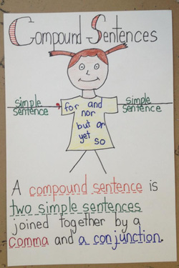

Slide 7
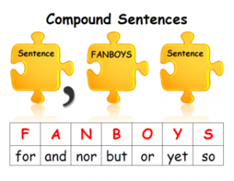

Slide 8
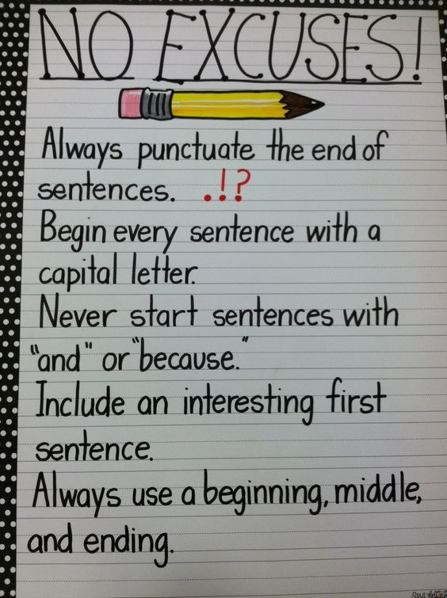

Slide 9
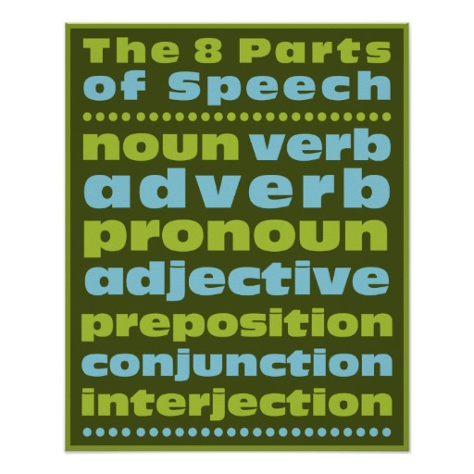

Slide 14
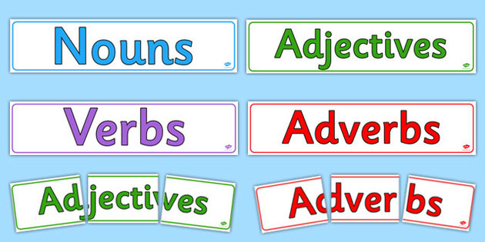

Slide 16
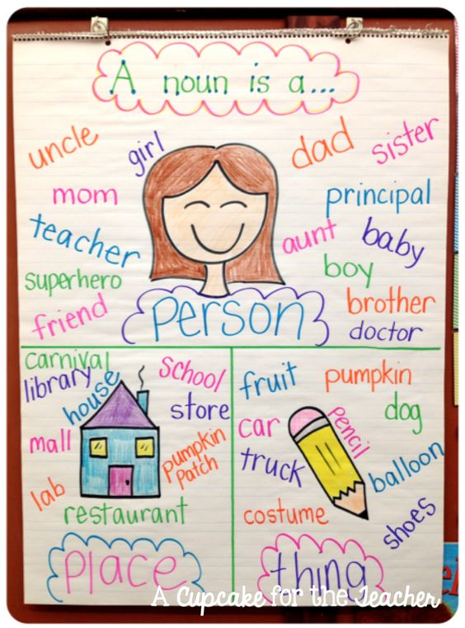

Slide 17
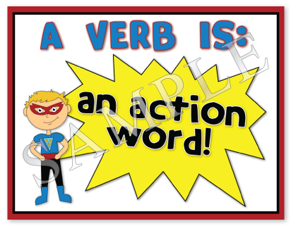

Slide 19
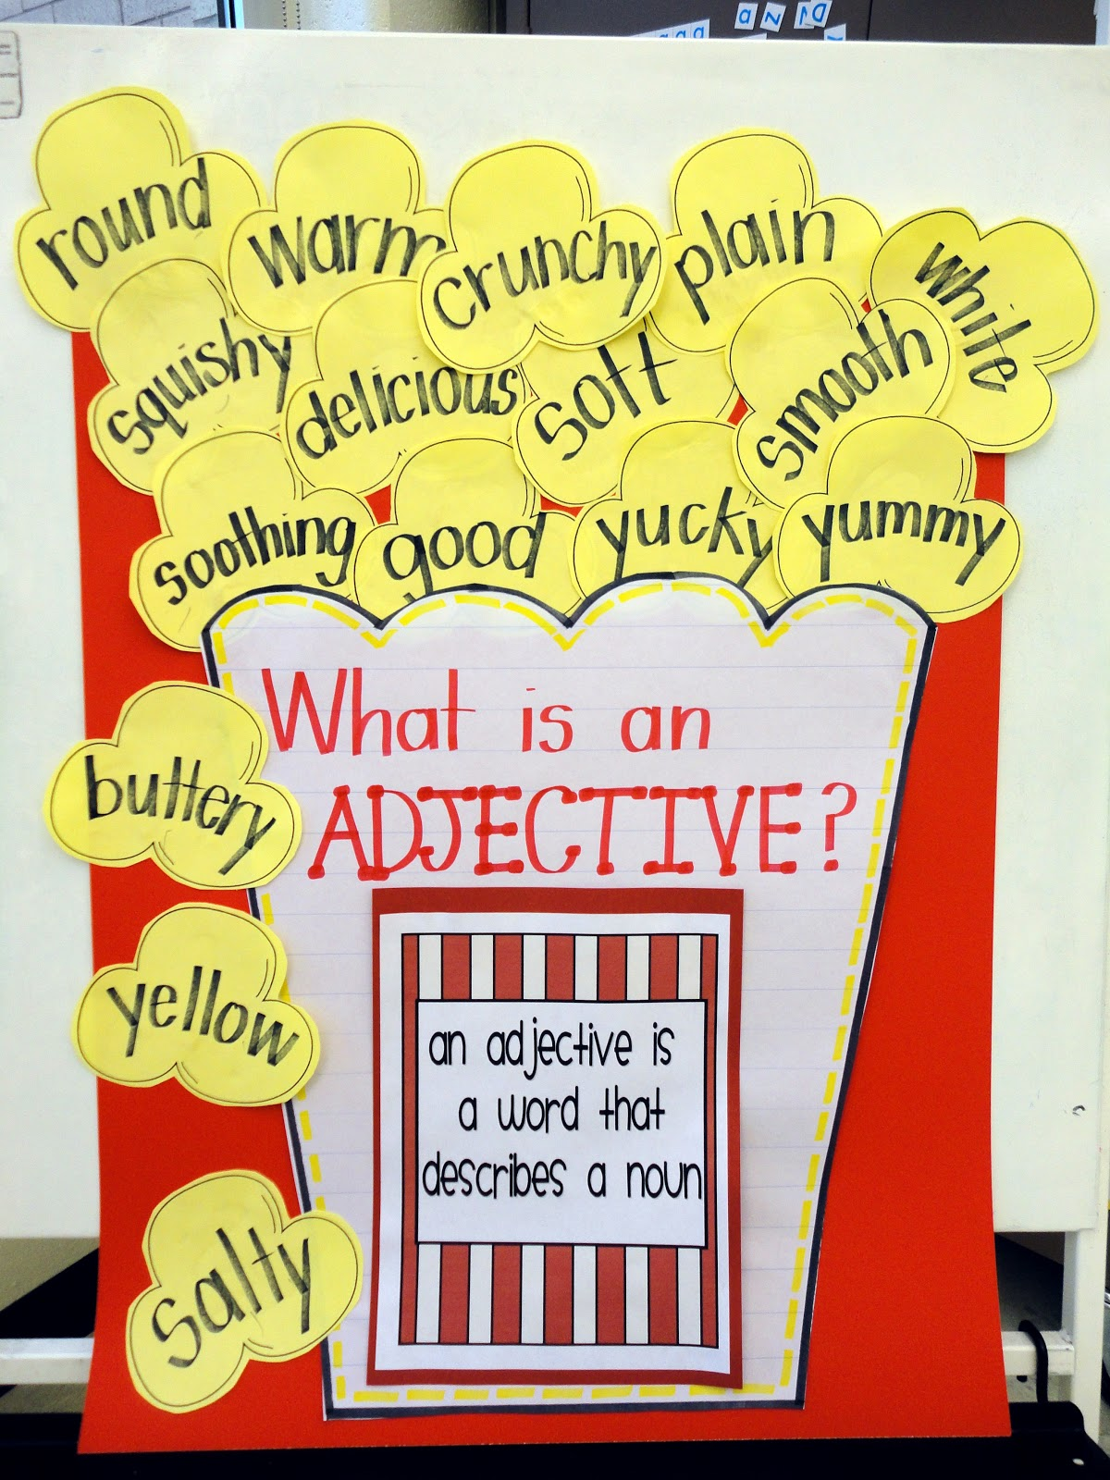

Slide 21
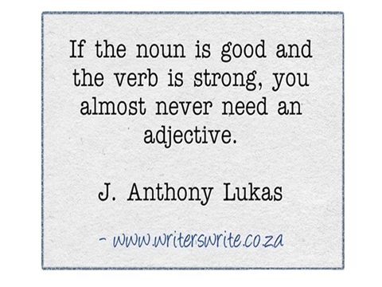

Slide 22
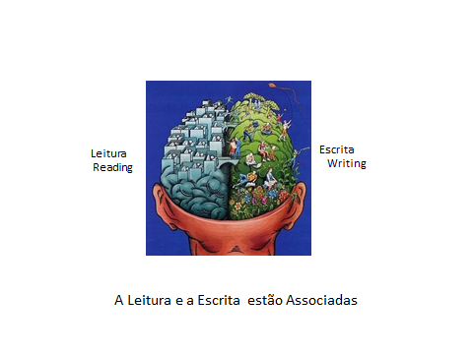

Slide 23
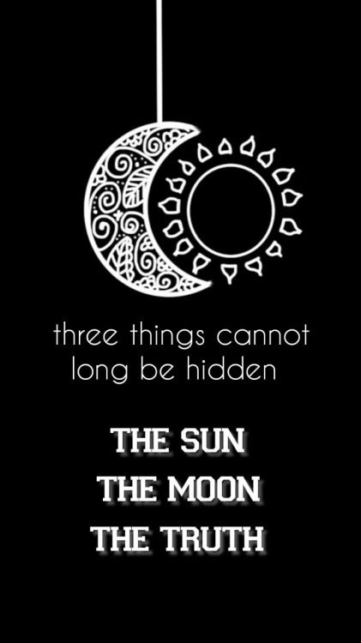

Slide 24
1. A Musical Revolution:
http://www.grammarsongs.com/
2. Four Kinds of Sentences Song, Four Types of Sentences by Melissa 2;10 min
https://www.youtube.com/watch?v=GjbGI-3rIFA

Slide 25
