Slide 4
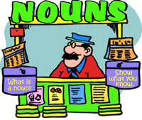
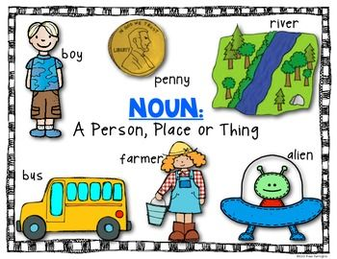

Slide 7
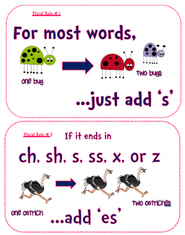

Slide 8
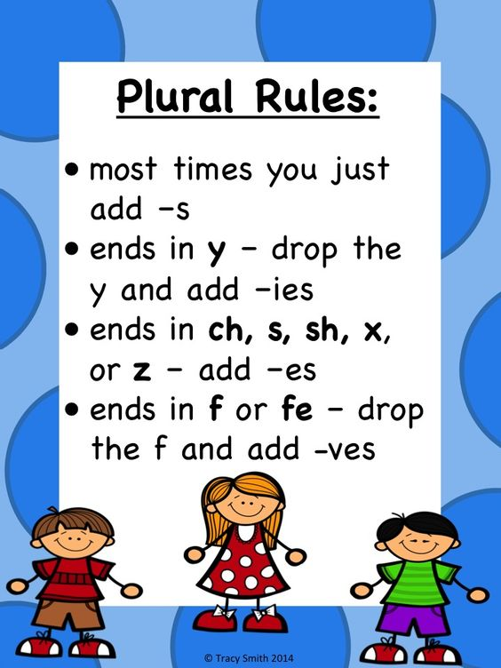

Slide 9
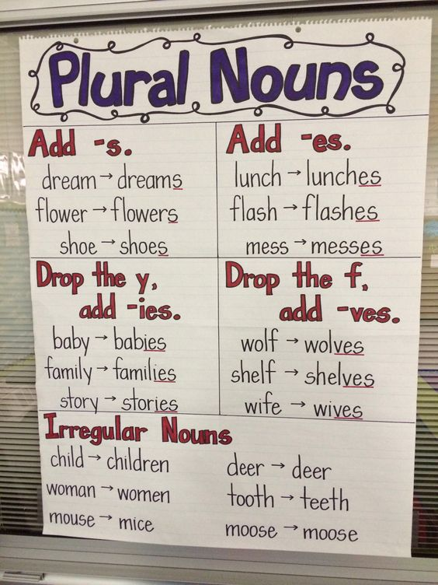

Slide 10
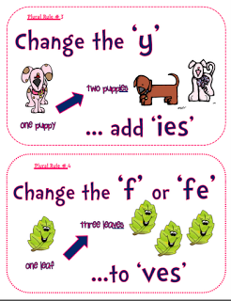

Slide 11
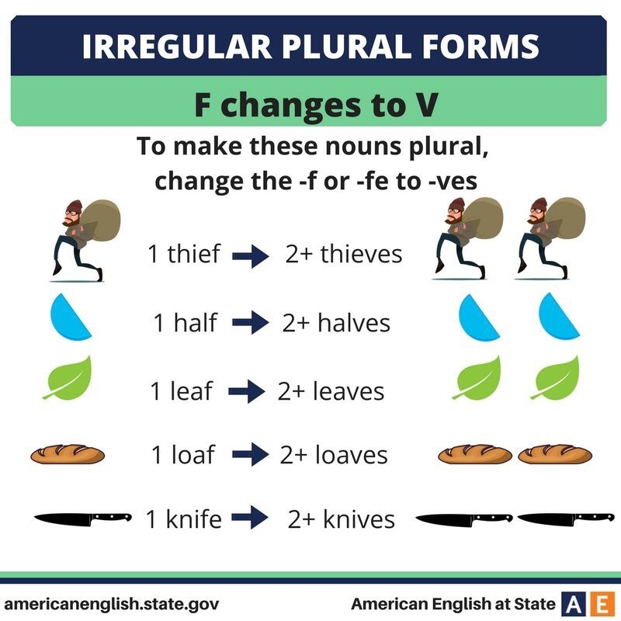

Slide 13
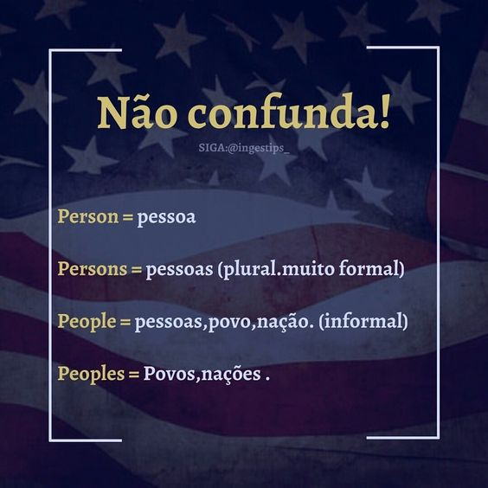

Slide 14
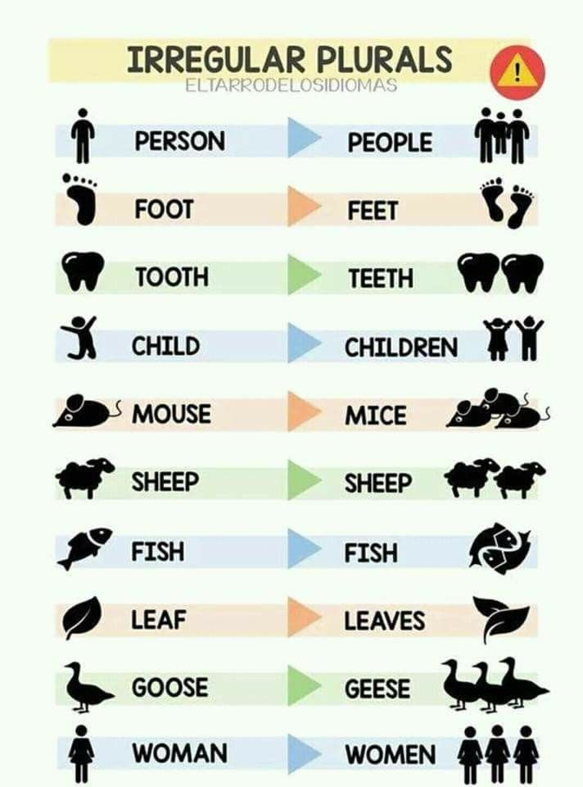

Slide 20
Learn English With Pleasure
The classification of English nouns. 5:25 min
http://lovelylanguage.com/grammar/grammar-rules/english-noun/

Slide 21
http://sahomeschoolmum.weebly.com/uploads/1/2/4/8/12483643/plural_rules_poster.pdf
Rules for Plural Nouns

Slide 22
NOUN SONG | LEARN ENGLISH | CHILDREN'S SONGS | FunKiddzTV
All About Nouns: English Grammar for Kids – FreeSchool 03:09 min.

